Slide 1
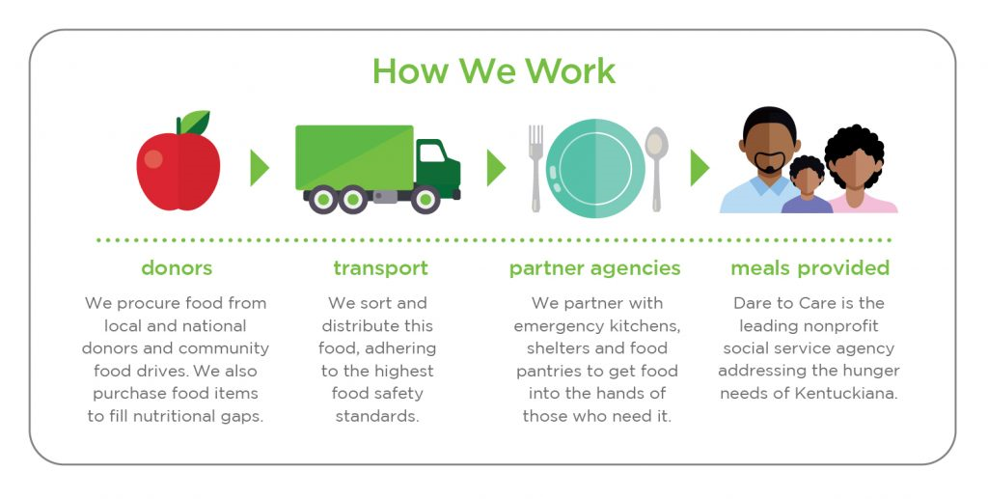
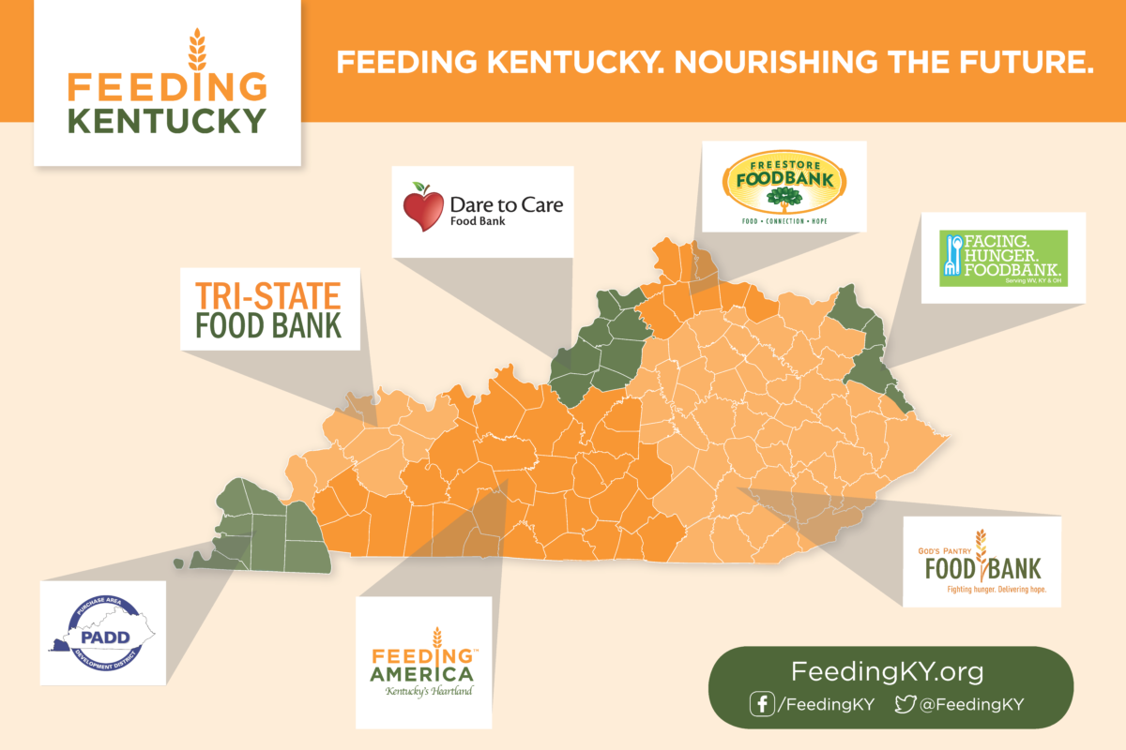
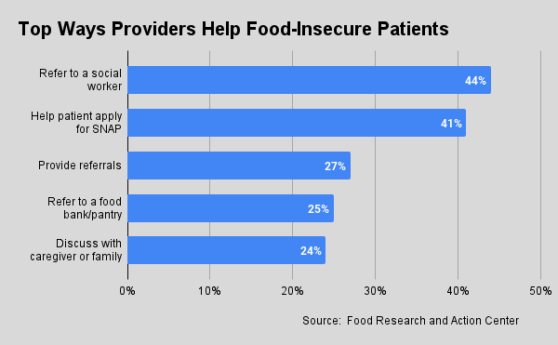
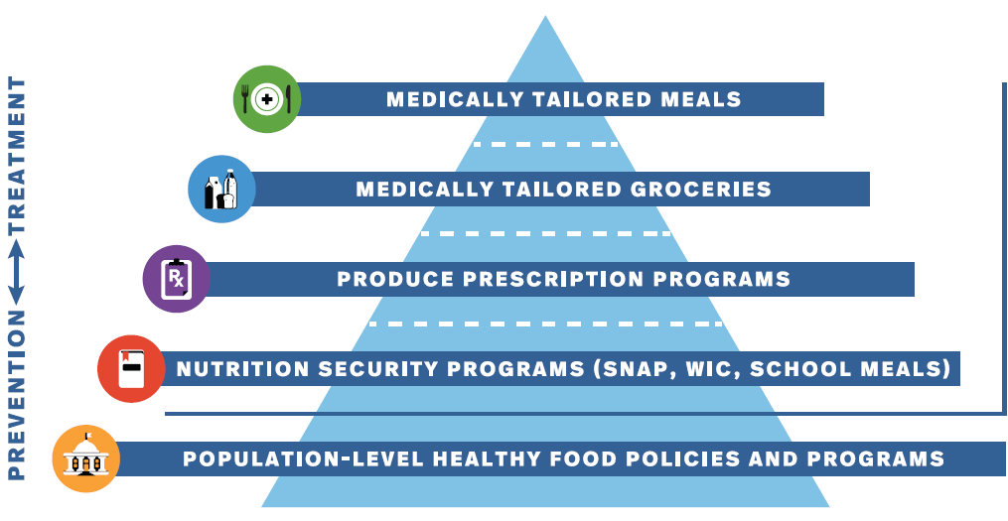

Slide 2
https://healthydebate.ca/2023/05/topic/food-prescriptions-food-insecurity/#comment
https://www.feedingamerica.org/hunger-in-america/kentucky
https://map.feedingamerica.org/county/2021/overall/kentucky
https://feedingky.org/
Book: "Reinventing Food Banks and Pantries" Katie Martin
www.DollarFor.org
https://mazdun.github.io/Louisville-Food-Security/#Food_Insecurity
https://www.lpm.org/news/2023-05-22/new-kentucky-pilot-programs-test-prescribing-food-as-medicine
https://public.tableau.com/app/profile/feeding.america.research/viz/TheHealthcareCostsofFoodInsecurity/HealthcareCosts
https://frac.org/screen-intervene
https://foodbanknews.org/the-next-big-thing-in-healthcare-partnerships/
https://foodbanknews.org/the-challenge-of-healthcare-hunger-relief-partnerships/
https://foodbanknews.org/food-program-puts-food-as-medicine-front-and-center/

